Slide 1


IT252 PROJECT
BLOGGING WEBSITE
Nithin S 221IT085
Ayush Kumar 221IT015
Jay Chavan 221IT020

Slide 2

Introduction
A blog is like an online journal or diary where people can write and share their thoughts, experiences, ideas, or expertise on various topics.
MERN Stack Blogging Website using React.js, Tailwind CSS and advanced authentication with robustness in user interaction and with features like commenting and searching.

Slide 3
Scope
Scope includes building a responsive, feature rich website catering to both content creaters and consumers.
Significance lies in fostering an interactive online community through user-friendly interface and advanced functionalities.
Content Diversity, Audience Engagement, Personal Expression, Community Building will be given more importance

Slide 4
Objective
Develop a MERN stack blogging website with modern features and robust functionality.
Create an engaging platform for content creators and consumers alike, promoting interaction and user engagement.
Implement all modern features to enrich user experience

Slide 5
Working of our Website
The system we have developed allows users to create their own blog, where users can publish their own opinions.
In this system there are admins who takes care of the Blog.
Only verified admins can create posts.
The posts may verified by the admins.There has category list where posts can be saved by relevant category.People can like, comment and share the posts.

Slide 6
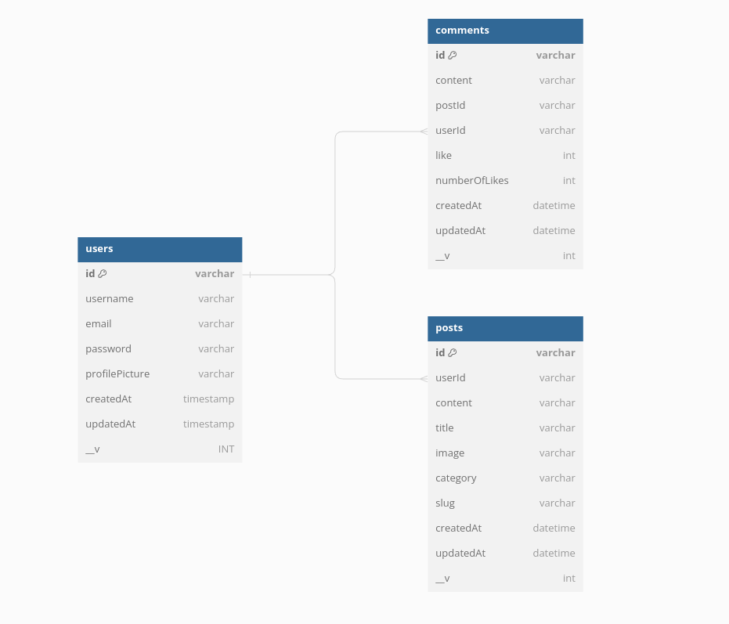
ER Diagram

Slide 7
Highlights of Our Website
Fully Responsive.
Compatible with PC, Tablet, Mobile Devices.
Light and Dark Mode Included.
Google OAuth Integration
Different Views for Registered Users, Unregistered Users and Blog Admins.
Search & Sort Functionality.
All Users have the ability to make, edit and delete posts.
And many more...

Slide 8









Tech Stack
Frontend : ReactJS, Tailwind CSS, Flowbite
ODM : Mongoose
Backend : ExpressJS, MongoDB, Firebase
Misc : Redux, JSON Web Tokens

Slide 9

System Design
Data
Backend
Frontend
Query

Slide 10
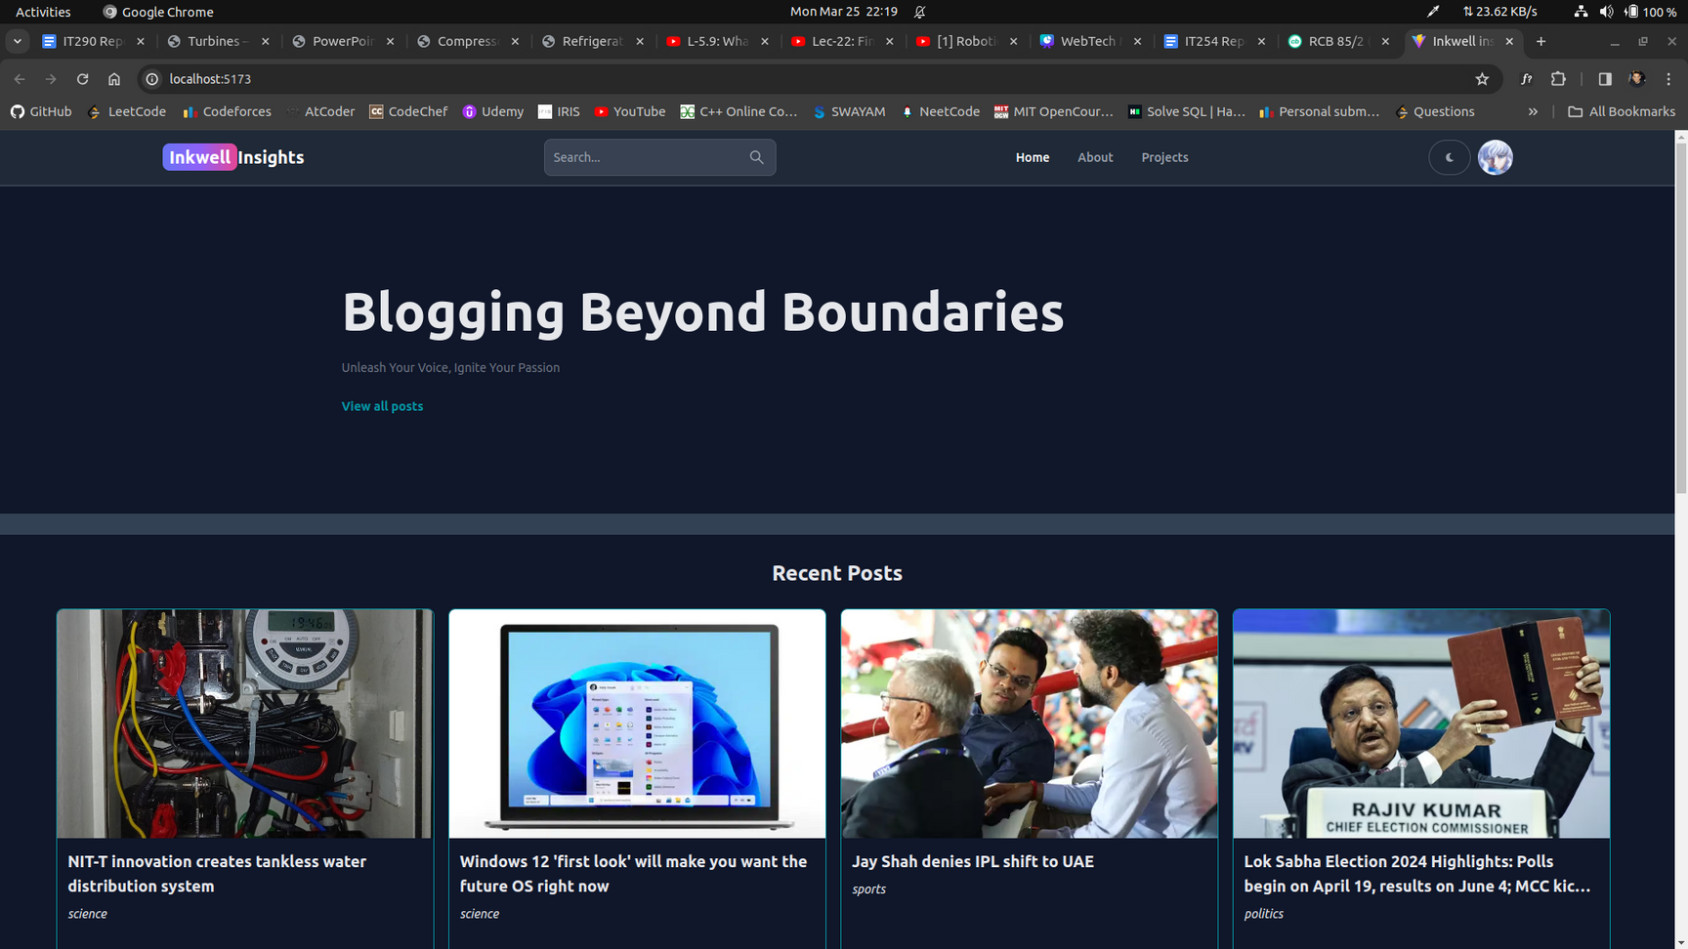
Results

Slide 11
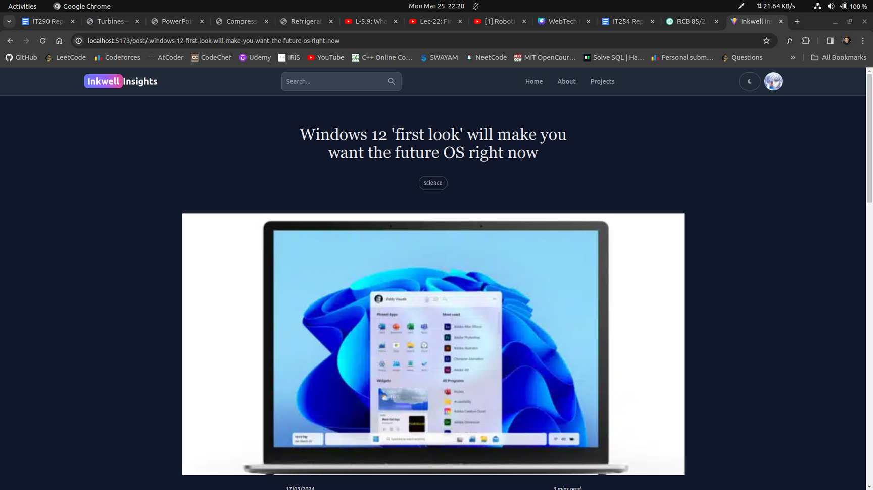

Slide 12
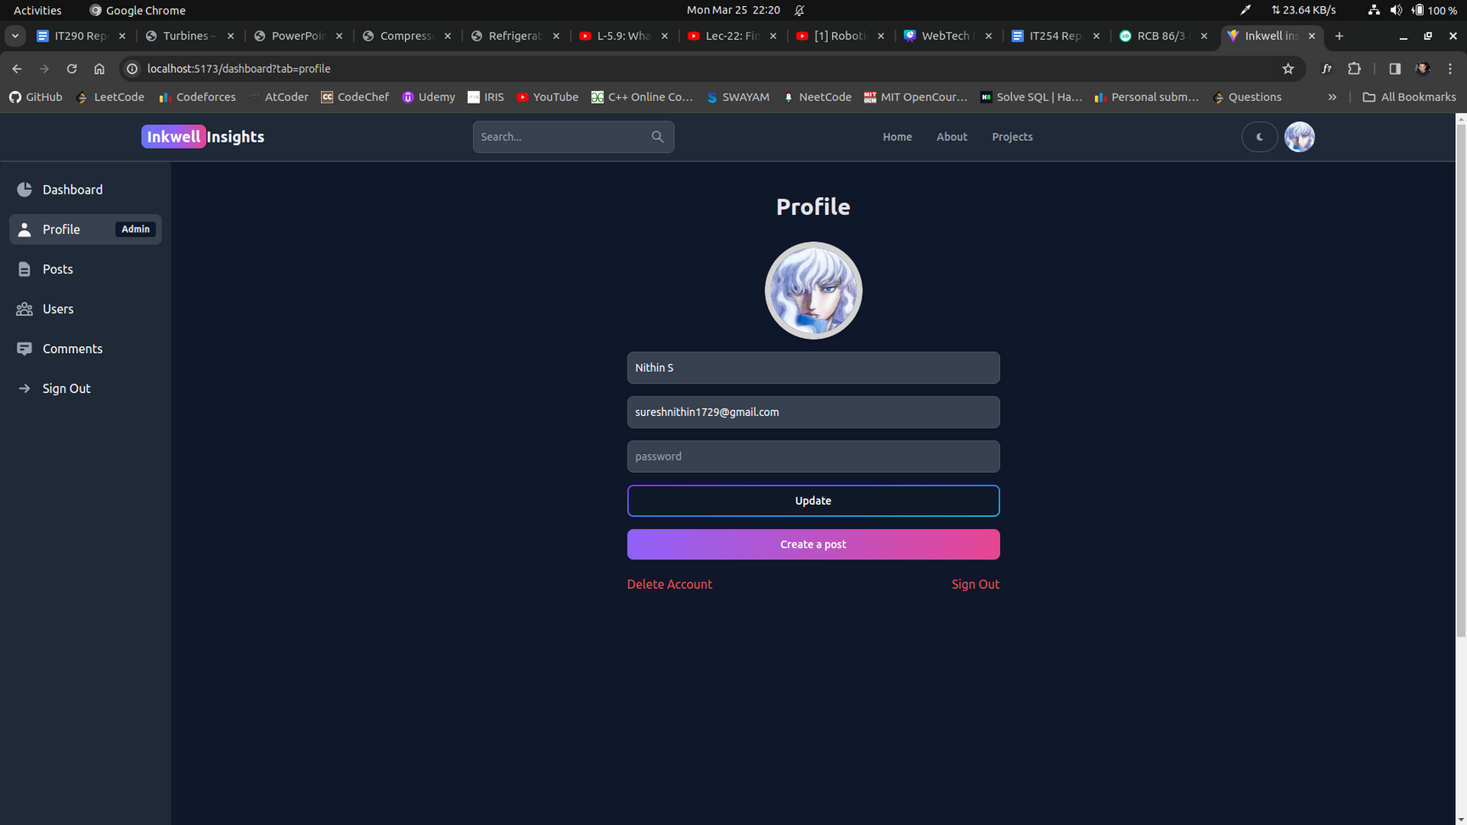
Results

Slide 13
Work Distribution
01
02
03
04
Set up project with React and Tailwind.
Create basic UI components like header footer.
Implement React Router Dom for navigation.
Implement JWT and Google Auth
Set up Redux Toolkit
Sign In , Up and Out
Admin Dashboard
Set up backend with nodejs and Expressjs
Connect MongoDB
Implement CRUD
Secure backend routes
Implement Search & Sort Functionality
Comment System
Dark Mode
Optimize & Debug
Nithin & Jay
Nithin & Ayush
Jay & Nithin
Combined

Slide 14
Future Work
Enhanced User Profiles
Hosting the Website
Advanced Analytics
Content Recommendation
Collaborative Editing
Monetization Options
Localization and Internationalization
Community Moderation Tools
Integration with External Platforms
Accessibility Improvements
Continuous Performance Optimization

Slide 15
References
J. L. Herrero, F. Lucio and P. Carmona, "Web services and web components," 2011 7th International Conference on Next Generation Web Services Practices, Salamanca, Spain, 2011, pp. 164-169, doi: 10.1109/NWeSP.2011.6088171. keywords: {Servers;Browsers;Web services;Computers;Europe;Software as a service;Web services;web application;component-based development;RIA},
S. R. Kumar, R. Sharma and K. Gupta, "Strategies for web application development methodologies," 2016 International Conference on Computing, Communication and Automation (ICCCA), Greater Noida, India, 2016, pp. 160-165, doi: 10.1109/CCAA.2016.7813710. keywords: {Object oriented modeling;Unified modeling language;Programming;Software;Computer architecture;Servers;XML;XP (Extreme Programming);WCML (Web Mark Up Language);CORBA (Common Object Request Broker Architecture);AWDWF (Agile Web Development with Web Framework)},
X. Li and J. A. Chishti, "The impact of emerging website design features," 2017 4th International Conference on Systems and Informatics (ICSAI), Hangzhou, China, 2017, pp. 1657-1662, doi: 10.1109/ICSAI.2017.8248550. keywords: {Testing;Usability;Libraries;Loading;Shape;Browsers;Tools;Emerging website design features;influence;accessibility;performance},
S. Otsuka, K. Kato and V. Klyuev, "Academic laboratory website development," 2015 17th International Conference on Advanced Communication Technology (ICACT), PyeongChang, Korea (South), 2015, pp. 791-794, doi: 10.1109/ICACT.2015.7224903. keywords: {Servers;Radiation detectors;Switches;Computers;Smart phones;Internet;Website Development;Responsive Web Design},

Slide 16







Thanks!

